Slide 1





Jedi-06 Group 4
Course Registration System

Slide 2


Stakeholders
1
Sponsors
Flipkart
2
SME's
Deepika Gajraj
Khushboo (order trainings)
3
Trainers
Amit Balyan

Slide 3

Agenda
01
Our Journey
02
Our Team
03
Team Structure
04
Problem Statement
05
Engineering Practices
06
Tech Stack
07
Demo
08
Development
09
Challenges & Learnings
10
Questions
Notes:
Time – 1 min

Slide 4

Our Journey
Notes:
Time - 2 mins

Slide 5
01.
02.
Unix &Git
UML Diagrams
Understanding Unix and Git Commands
Requirement Understanding and diagram design
04.
03.
Java8
POS Application&SQL
Understanding basics of java and exception handling
Developing a POS application using Java and MySQL
Action Plan
05.
06.
Java REST
Jersey&Drop Wizard
Understanding about Java RESTful services
REST API development using jersey and DropWizard

Slide 6
Our next starts
NOW
Notes:
Time – 1 min
Swati

Slide 7
2 WEEKS OF TRAINING + PROJECT DEMO
12 DAYS
96 HOURS
5760 MINUTES
345600 SECONDS
LIMITLESS KNOWLEDGE

Slide 8
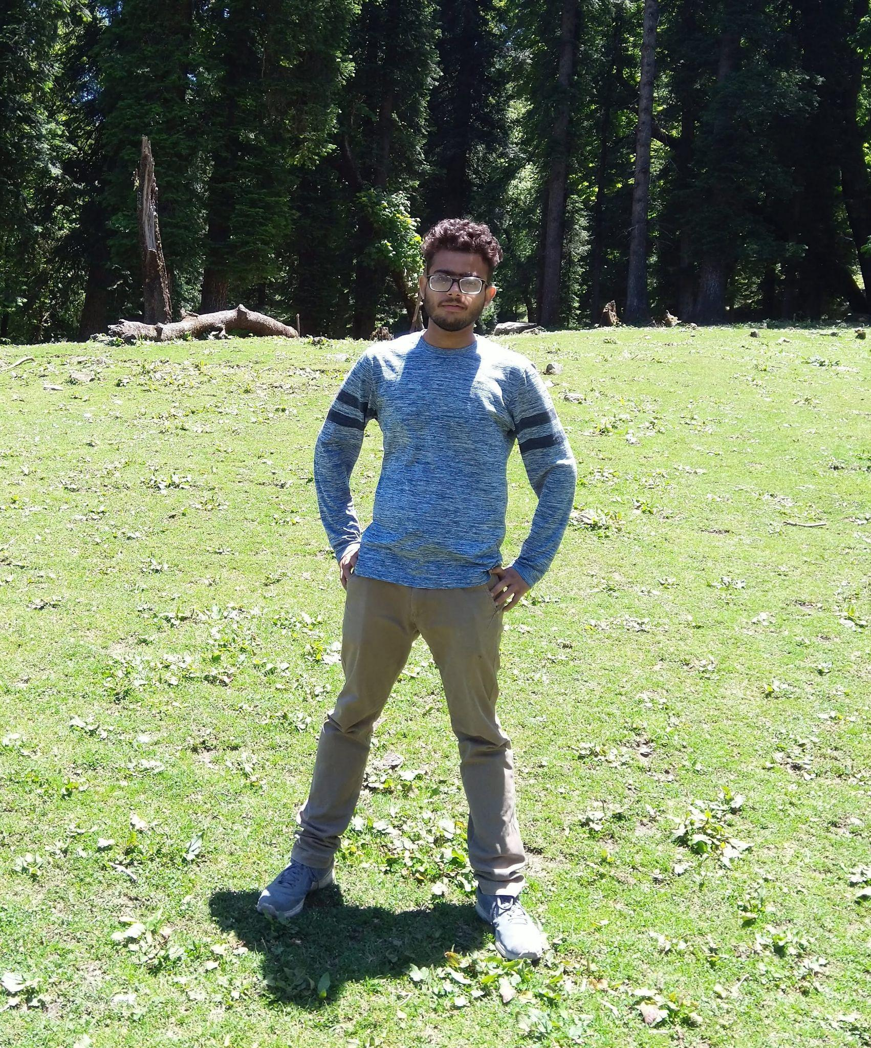
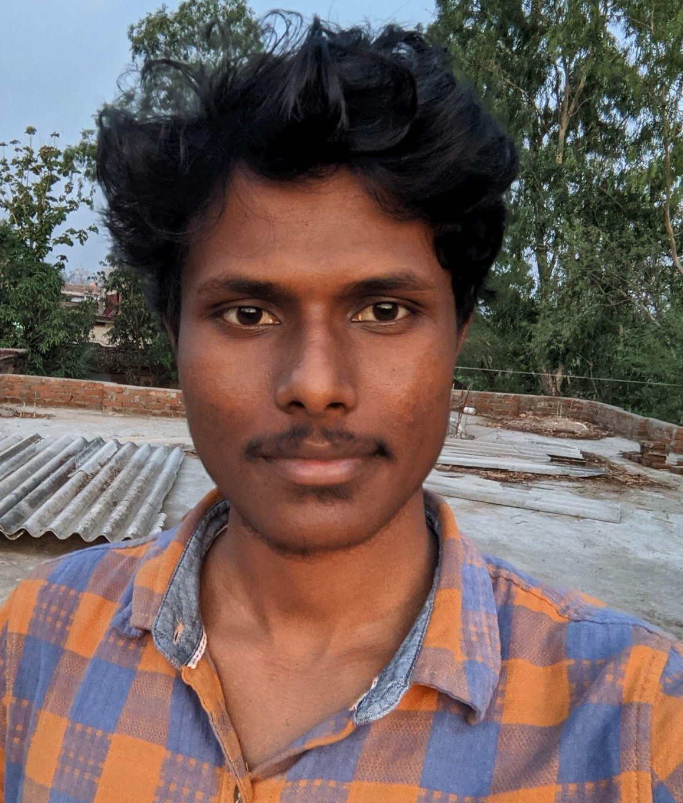
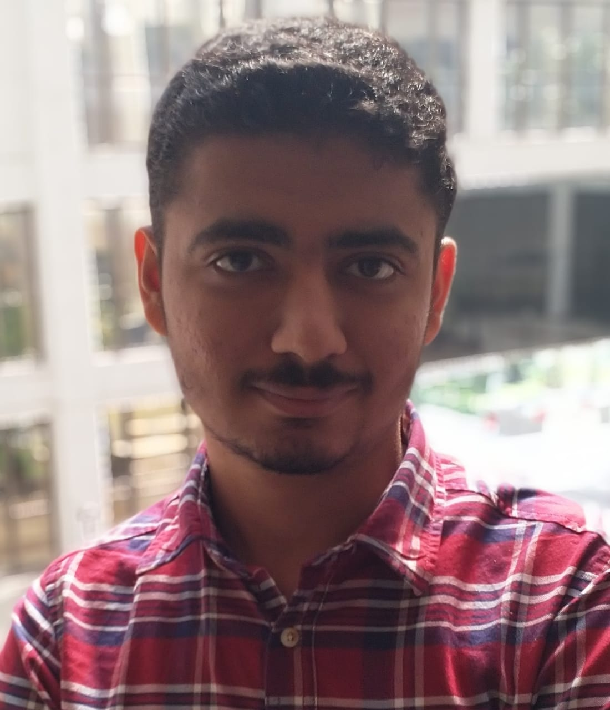
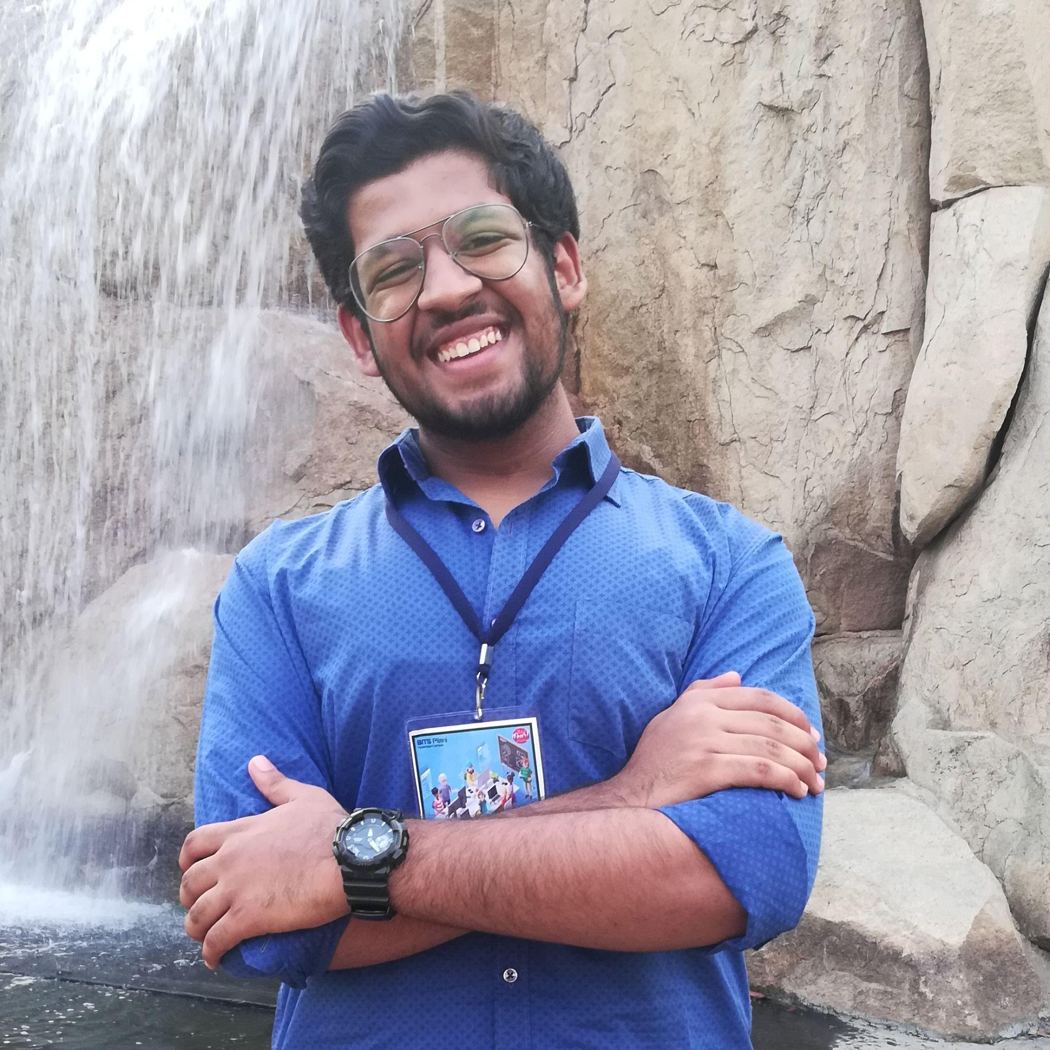
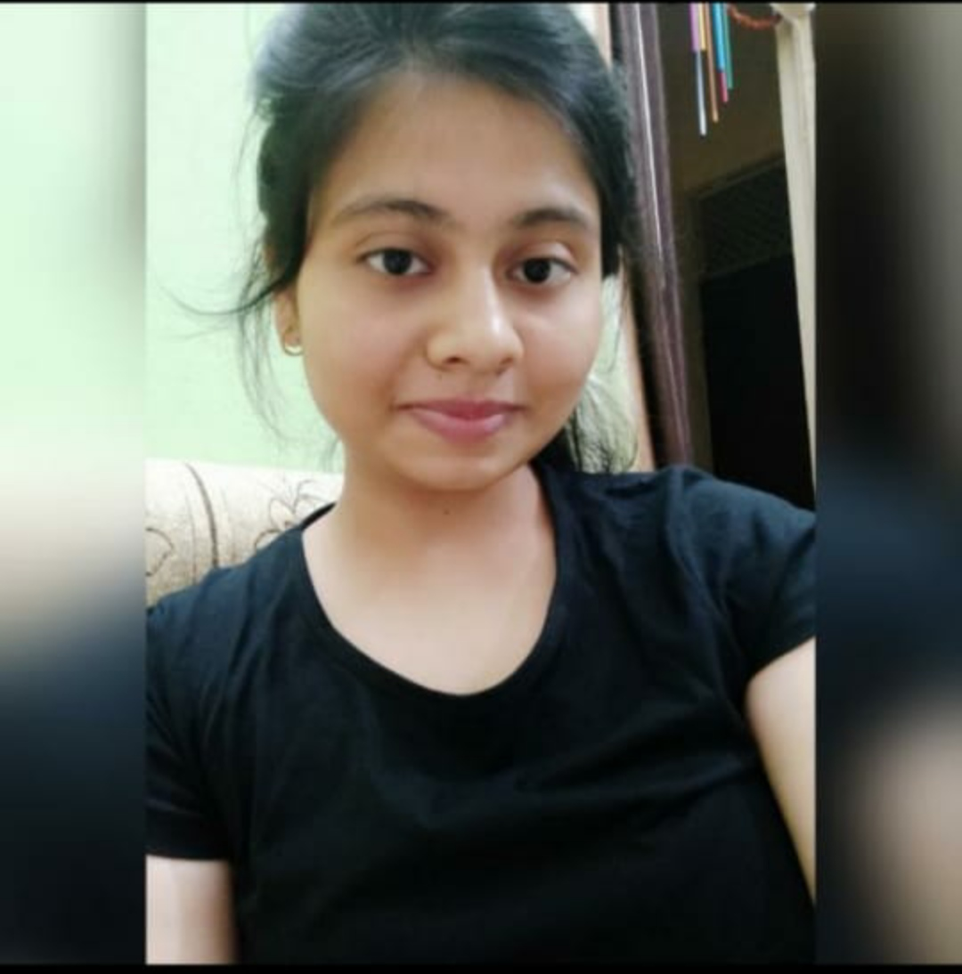
(Provider OP)
Abdul Samad Siddiqui
(Driver OP)
Brijesh Kumar Maurya
(Developer OP)
THE
TEAM
Nipun Pruthi
(Explorer OP)
Tushar Aggarwal
(Saviour OP)
Shivangi Jaiswal
(Provider OP)

Slide 9
Contribution:
Name | Responsibility
Brijesh Kumar Maurya | Implemented Professor, User functionalities, UML artifacts
Abdul Samad Siddiqui | Implemented Student, User functionalities UML artifacts
Tushar Aggarwal
Shivangi Jaiswal | Implemented Admin functionalities UML artifacts
Nipun Pruthi | Integration, Testing, UML artifacts

Slide 10


Contribution:
PROJECT GOALS

Slide 11
Problem Statement
Entities involved are: Student, Professor, Admin
Students should be able to Register for courses and view an electronic report card at the end of the semester.
Professors access the system to choose and teach courses, record grades.
The Admin should be able to Approve a Student, Register a Professor, add/remove course from course catalog.
The System should allow students to select courses (4 minimum with choice to add 2 extra courses at max).
Course offerings will have a maximum of ten students and a minimum of three students.
After the registration, the system sends information to the billing system so that the student can be billed for the semester.
Develop a Course Registration System

Slide 12

Engineering
Practices

Slide 13
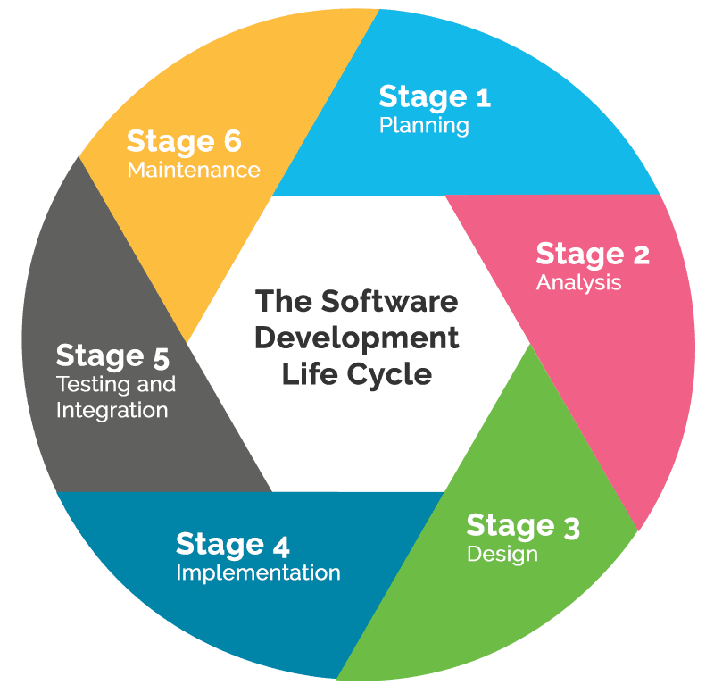
Requirement Gathering
Tech Stack Selection
Testing & Bug Fixes
UML Artifacts, Architecture Design
Code development

Slide 14





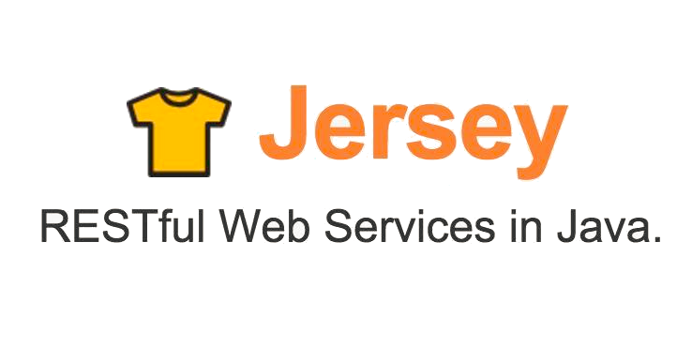


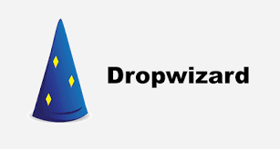



Slide 15

ARCHITECTURE DESIGN

Slide 16

SYSTEM ARCHITECTUTE
HTTP Request
HTTP Response
Java Main Class(UI)
Business Class(BC)
Database Class(DAO)

Slide 17
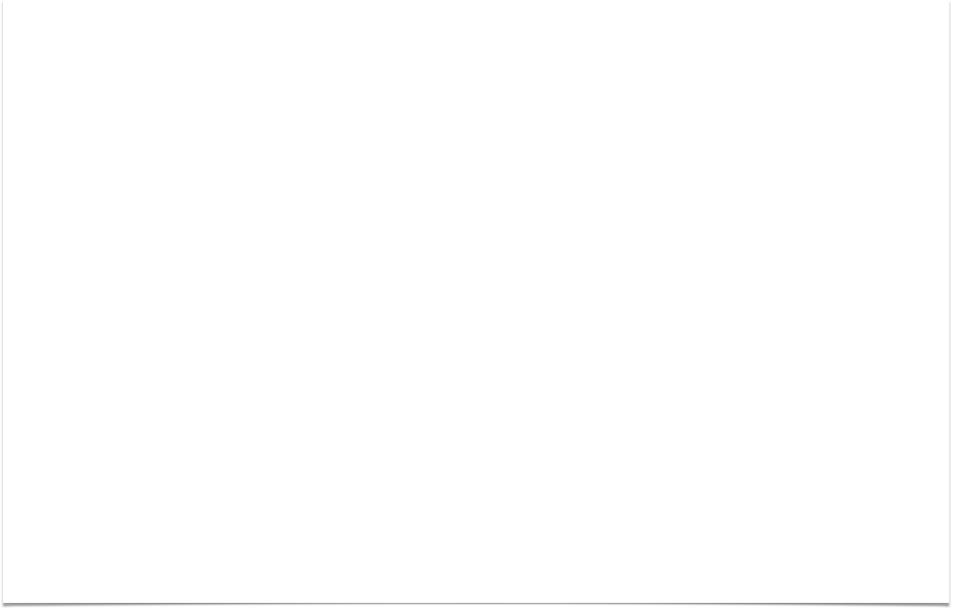


Slide 18

LEARNINGS AND CHALLENGES

Slide 19
LEARNINGS
Familiarization with Unix Commands.
Getting hang of the basic Git commands.
Software Development Life Cycle.
Knowledge and Implementation of Activity, Sequence and Use Case Diagram.
Java 8 features.
Integration of REST Services with Java code using Tomcat and Jersey.
Dropwizard Integration and Advantages.
Usage of Postman for testing APIs.
Javadoc Generation & basic Application Monitoring.

Slide 20
Understanding the problem statement and initial implementation using Use Case, activity, sequence and class diagram.
Installing software on multiple environments.
Git merge conflicts.
Resolving jar and version dependencies.
Migration of project from one tech stack to another.
Database integration challenges.
Migration from one tech stack to another
CHALLENGES

Slide 21

ANY
QUESTIONS?

Slide 22
THANK YOU!!

